Slide 1
Sprint 1 Review
[Data Formats and Terminology]

Slide 2

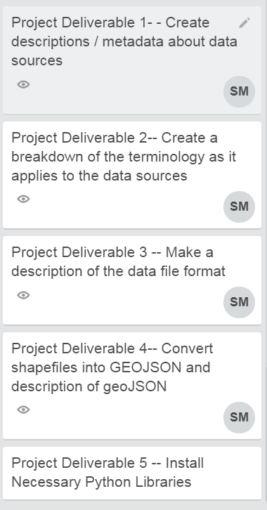




OBJECTIVES:

Slide 3
QUESTIONS:
Q1. What kind of data sets do I need to reference to write environmental assessments? Q2. What terms do I need to know to work with geospatial files?
Q3. What kind of data file formats do I see for the data sets I use regularly? Q4. How do I convert shape files to json or geojson? Q5. What libraries are most useful for geospatial work?

Slide 4
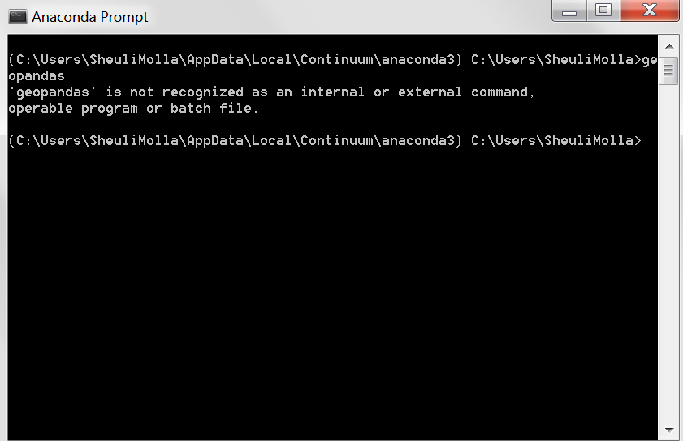



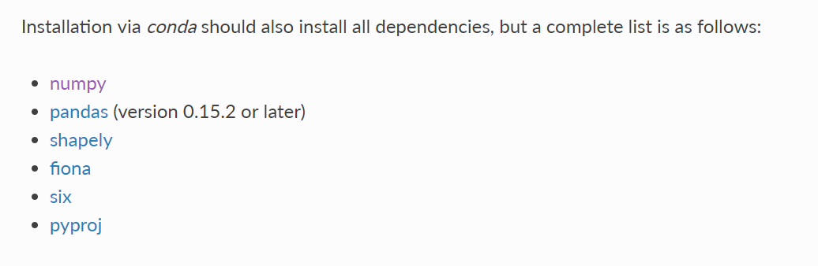
DOWNLOADING GEOSPATIAL LIBRARIES WITH ANACONDA PROMPT:
GEOPANDAS, FIONA, ET AL.

Slide 5
DATA FORMATS:
Geospatial data is formatted in many ways.
RASTER
ADRG – National Geospatial-Intelligence Agency DRG) – digital scan of a paper USGS topographic map
ECRG – National Geospatial-Intelligence Agency (NGA)'s Enhanced Compressed ARC Raster Graphics (Better resolution than CADRG and no color loss)
ECW – Enhanced Compressed Wavelet (from ERDAS). A compressed wavelet format, often lossy.
Esri grid – proprietary binary and metadataless ASCII raster formats used by Esri
GeoTIFF – TIFF variant enriched with GIS relevant metadata
IMG – ERDAS IMAGINE image file format
JPEG2000 – Open-source raster format. A compressed format, allows both lossy and lossless compression.
MrSID – Multi-Resolution Seamless Image Database (by Lizardtech). A compressed wavelet format, allows both lossy and lossless compression.
netCDF-CF – netCDF file format with CF medata conventions for earth science data. Binary storage in open format with optional compression. Allows for direct web-access of subsets/aggregations of maps through OPeNDAPprotocol.
RPF – Raster Product Format, military file format specified in MIL-STD-2411^{[4]}
CADRG – Compressed ADRG, developed by NGA, nominal compression of 55:1 over ADRG (type of Raster Product Format)CIB – Controlled Image Base, developed by NGA (type of Raster Product Format)
VECTOR
AutoCAD DXF – contour elevation plots in AutoCAD DXF format (by Autodesk)
Cartesian coordinate system (XYZ) – simple point cloud
Digital line graph (DLG) – a USGS format for vector data
Esri TIN - proprietary binary format for triangulated irregular network data used by Esri
Geography Markup Language (GML) – XML based open standard (by OpenGIS) for GIS data exchange
GeoJSON – a lightweight format based on JSON, used by many open source GIS packages
GeoMedia – Intergraph's Microsoft Access based format for spatial vector storage
ISFC – Intergraph's MicroStation based CAD solution attaching vector elements to a relational Microsoft Access database
Keyhole Markup Language (KML) – XML based open standard (by OpenGIS) for GIS data exchange
MapInfo TAB format – MapInfo's vector data format using TAB, DAT, ID and MAP files
National Transfer Format (NTF) – National Transfer Format (mostly used by the UK Ordnance Survey)
Spatialite – is a spatial extension to SQLite, providing vector geodatabase functionality. It is similar to PostGIS, Oracle Spatial, and SQL Server with spatial extensions
Shapefile – a popular vector data GIS format, developed by Esri
Simple Features – Open Geospatial Consortium specification for vector data
SOSI – a spatial data format used for all public exchange of spatial data in Norway
Spatial Data File – Autodesk's high-performance geodatabase format, native to MapGuide
TIGER – Topologically Integrated Geographic Encoding and Referencing
Vector Product Format (VPF) – National Geospatial-Intelligence Agency (NGA)'s format of vectored data for large geographic databases

Slide 6
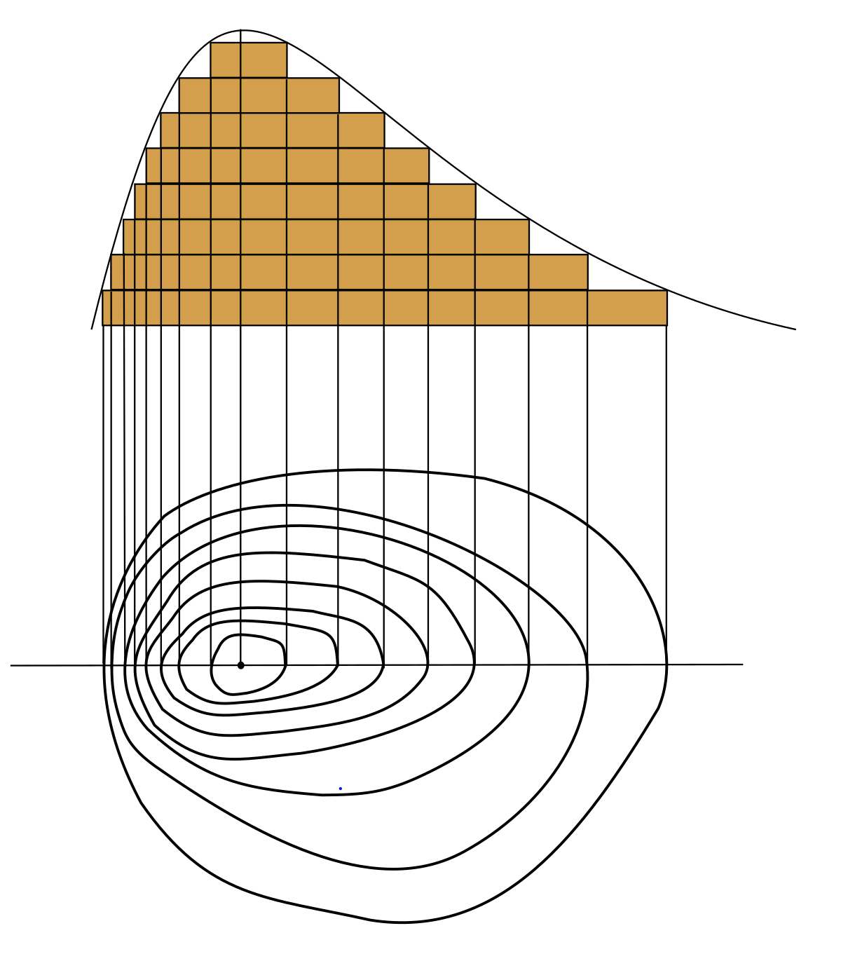
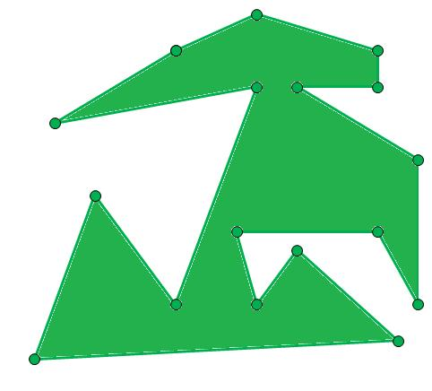

FORMATS BEST FORMATS FOR ME
For my purposes, I am working almost exclusively with shapefiles (.shp), which were developed by ESRI for use in ArcGIS programs.
Similarly useful json and geojson files may be used with open source software (such as Mapbox).
BOTH Raster file types store the following information:
LOCATION
SHAPE
ATTRIBUTES

Slide 7
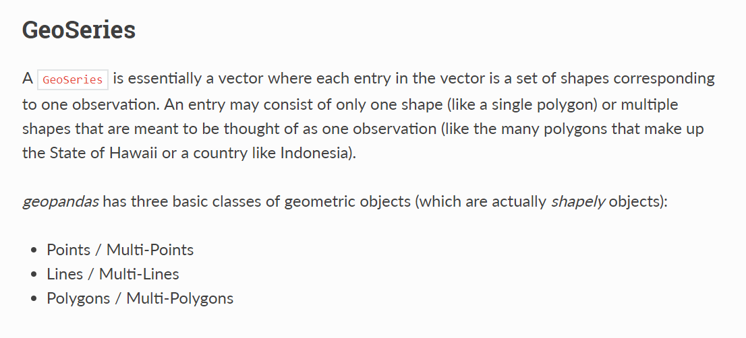
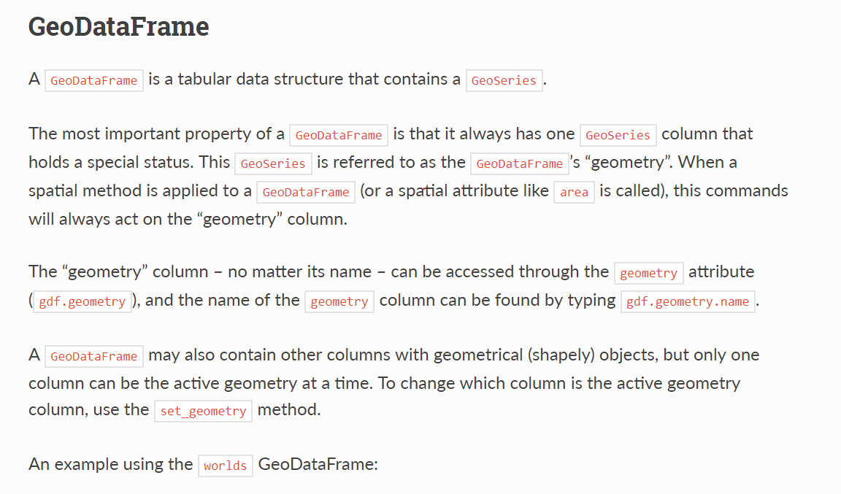

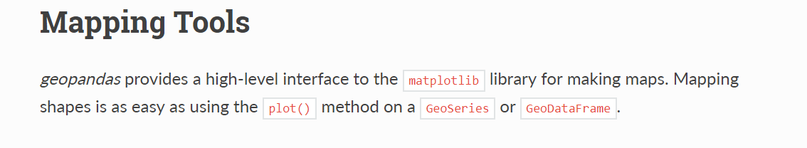
AFTER SOME TIME READING FROM THE GEOPANDAS WEBSITE…

Slide 8
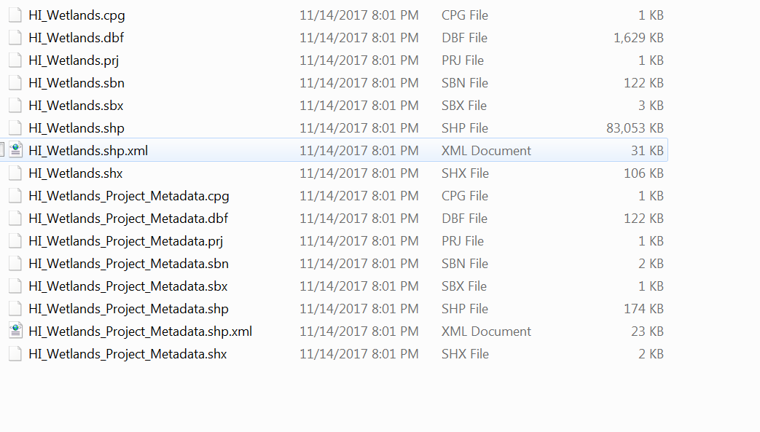
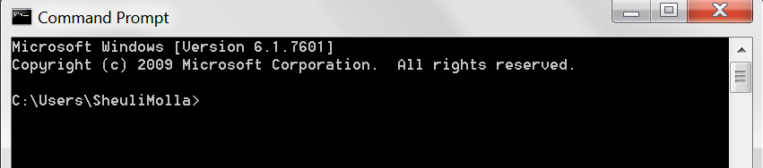
AND FUSSING WITH SOME WETLANDS DATA…

Slide 9
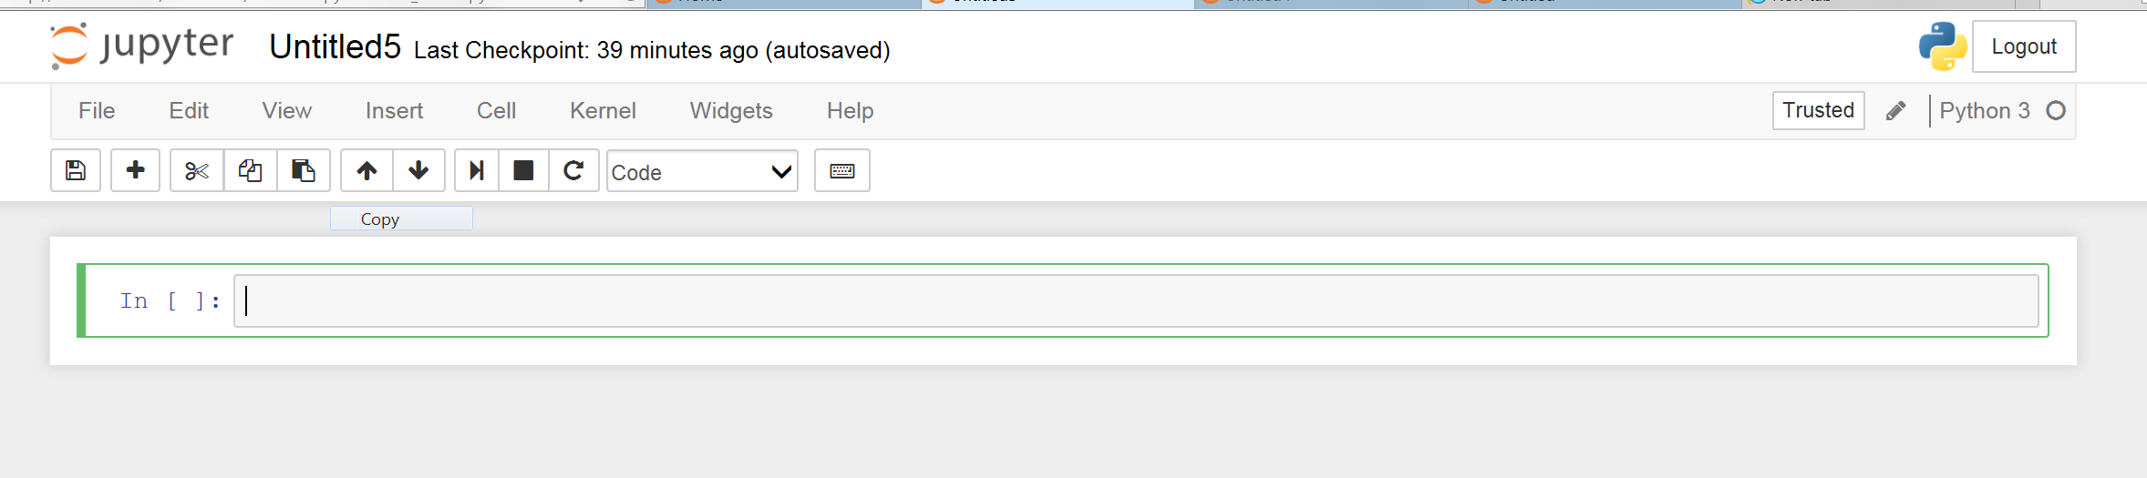
AND FIDDLING WITH MY JUPITER NOTEBOOK…

Slide 10
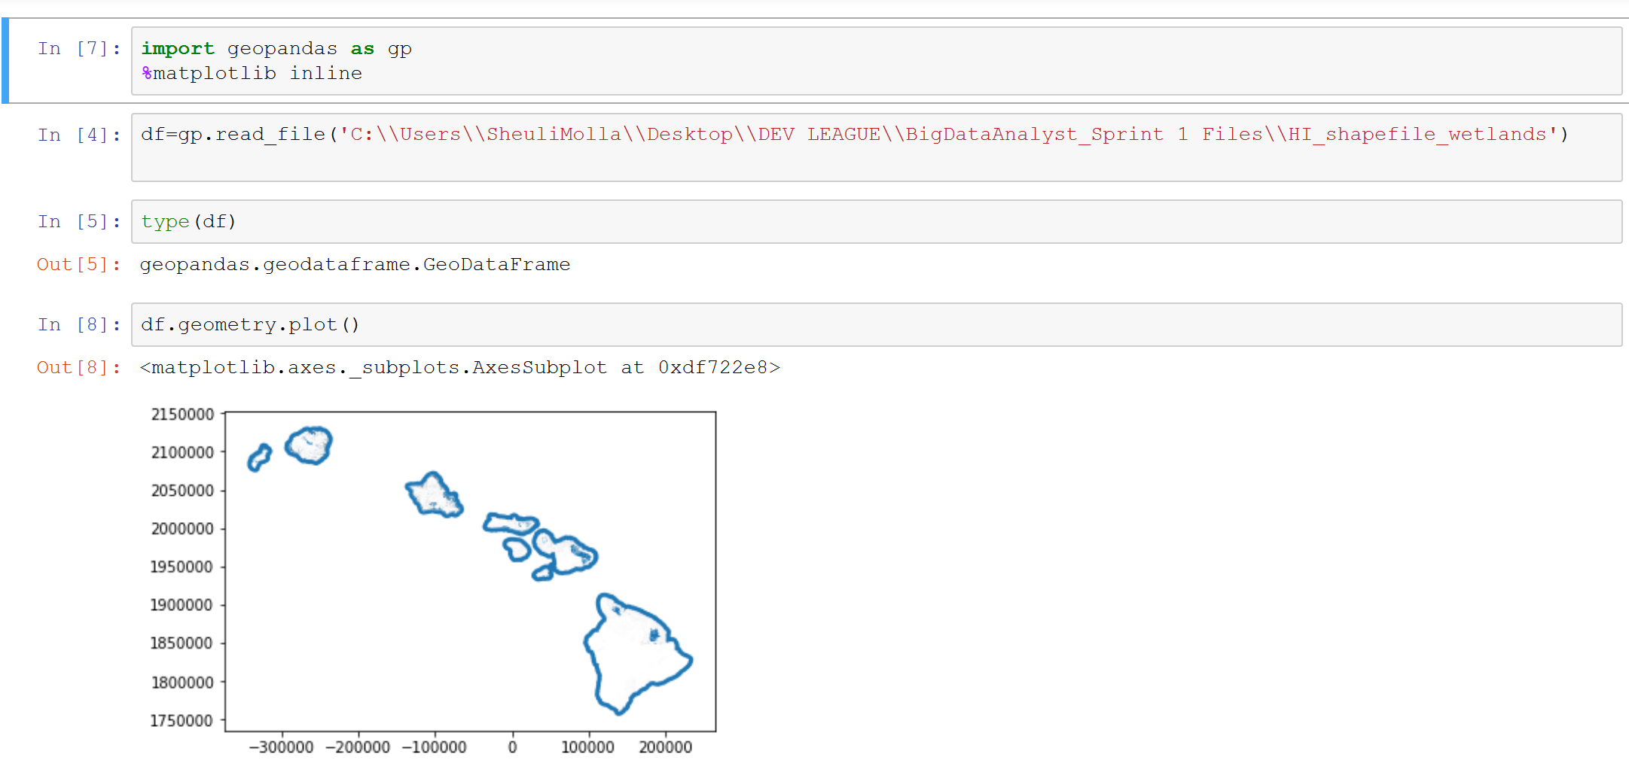
…I MADE THIS

Slide 11
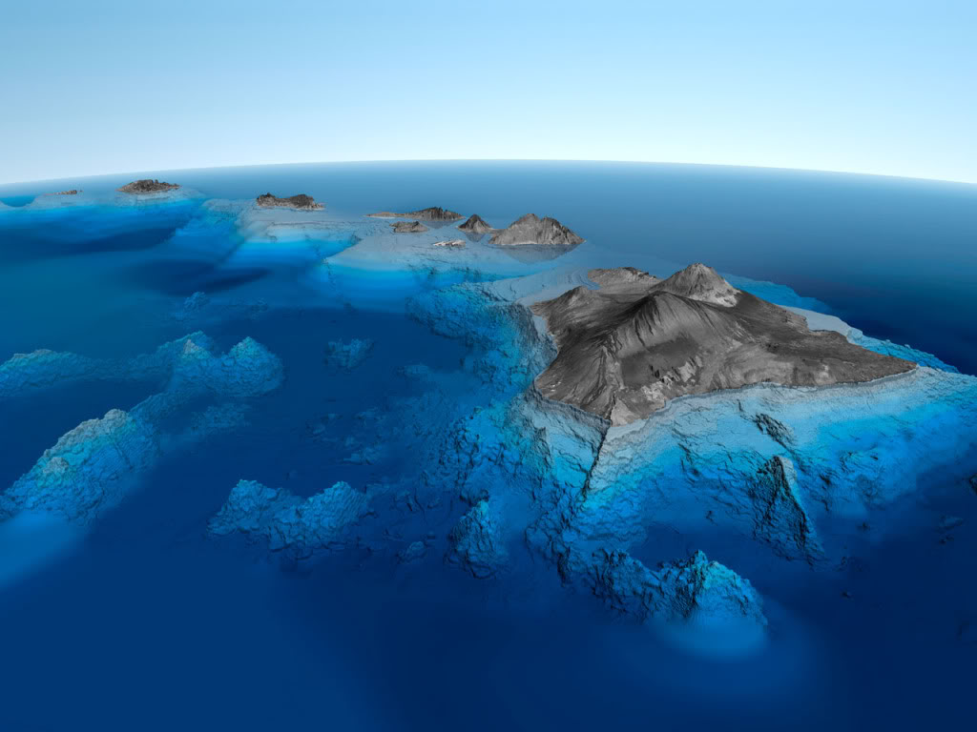

I IMPORTED A DATA FILE OF ALL OF HAWAII’S WETLANDS AND MAPPED THEM WITH LESS THAN 8 LINES OF CODE, AND I LEARNED A LOT IN THE PROCESS

Slide 12

Fin

